Slide 1
Recursion
Saif Hassan

Slide 2


Slide 3
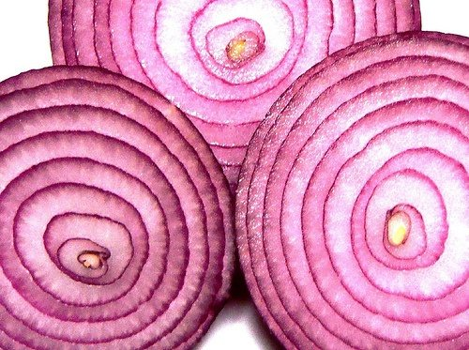

Slide 4


Slide 5
Calling Methods
Methods can call other methods
Can a method call itself?
Yes! This is called a recursive method (function)
“A method within a method”

Slide 6
Example 01
void test(int n) {
if (n > 0) {
System.out.println(n);
test(n-1);
System.out.println(n);
}
}
Trace the execution of test(4)

Slide 7
Example 02
void test(int n) {
if (n > 0) {
System.out.println(n);
test(n-1);
System.out.println(n);
}
}
Trace the execution of test(-4)

Slide 8
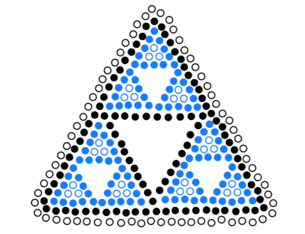
Recursion?
Recursion is a method of solving problems that involves breaking a problem down into smaller and smaller subproblems
Usually recursion involves a function calling itself

